Slide 1
Gesture Master
Team 10 Project

Slide 2
Table of Content
Problem Faced By The Healthcare Industry
Our Solution
How Does It Work
Real Life Application
Conclusion

Slide 3
Problem Facing The Healthcare Industry

Slide 4

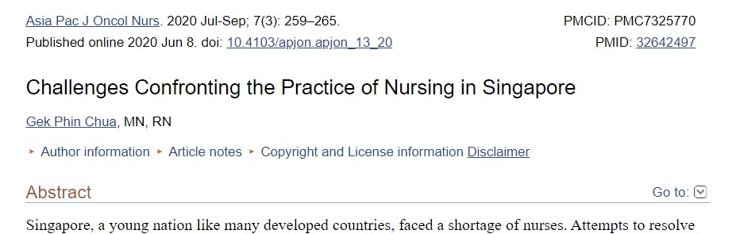
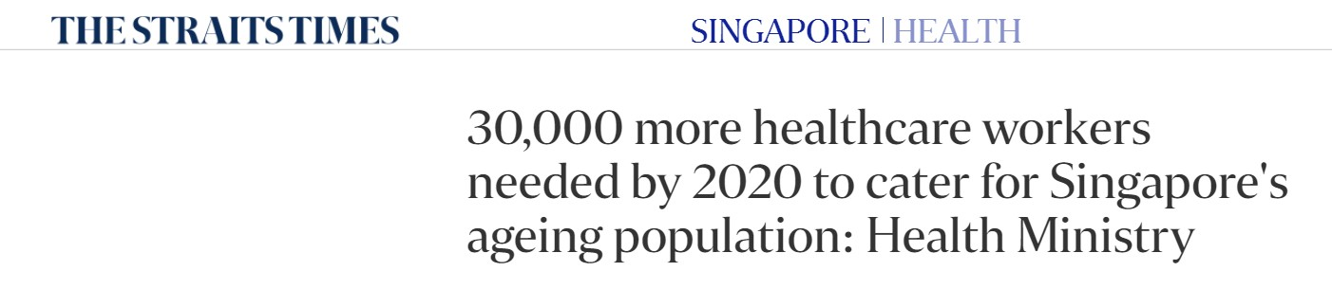
Problem Facing The Healthcare Industry

Slide 5

Problem Facing The Healthcare Industry
Rapid population growth
Aging Population
Chronic illness
Opening of new hospitals
Manpower shortage

Slide 6
Our Solution

Slide 7
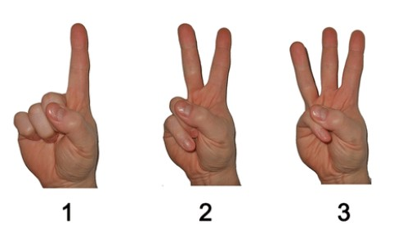
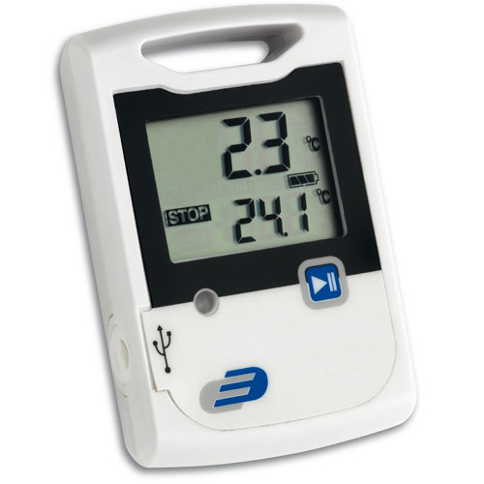
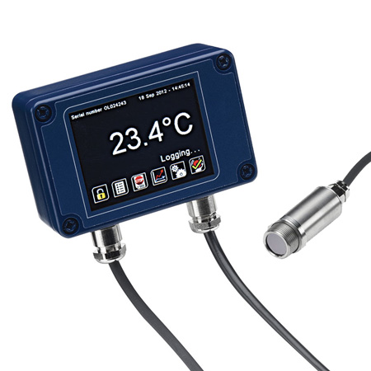
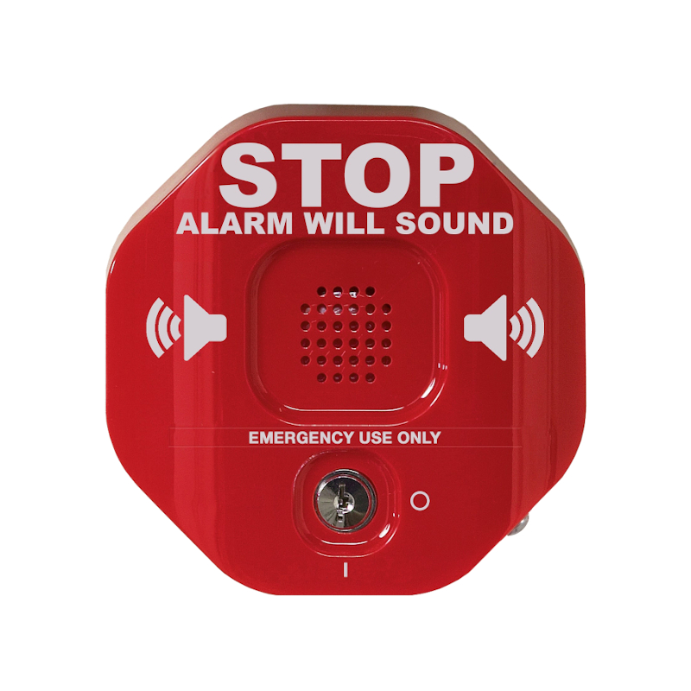
Our Solution

Slide 8
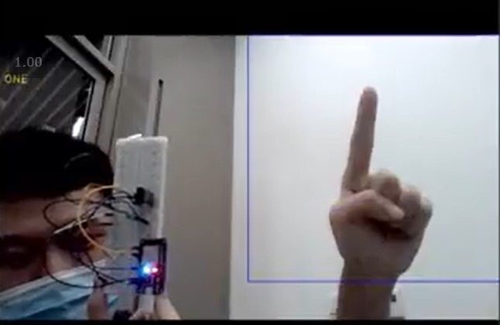
Our Solution
Gesture detection to automate simple medical equipments
Reduce manpower requirement by the healthcare sector

Slide 9
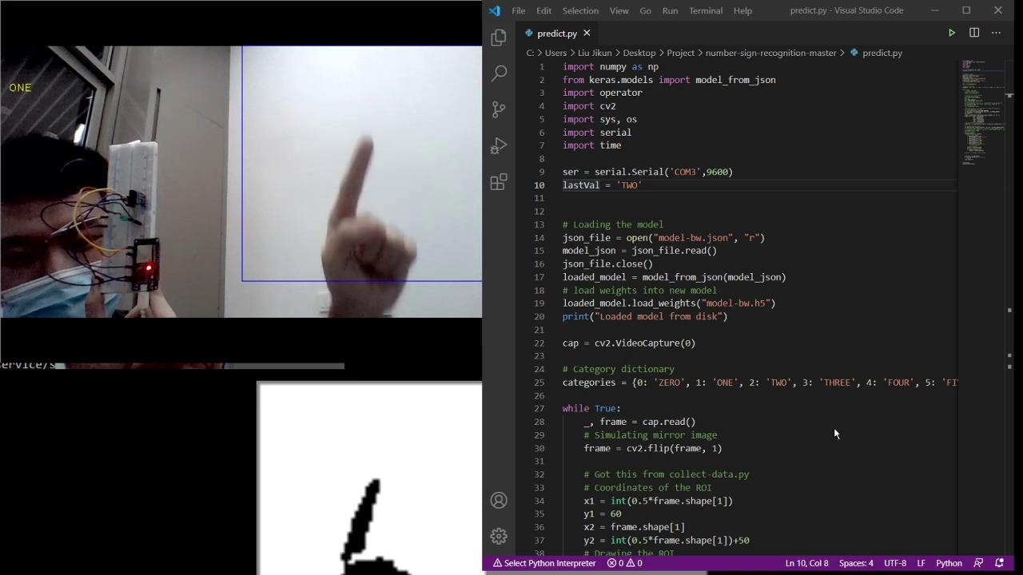
Demonstration of Our Solution

Slide 10
How does it work?

Slide 11

Siri:
Speech Interpretation and Recognition Interface
Based on NLP
Activate the instructions in IOS
Gesture Master:
Gesture Recognition Interface
Based on computer vision
Activate the functions in Arduino

Slide 12
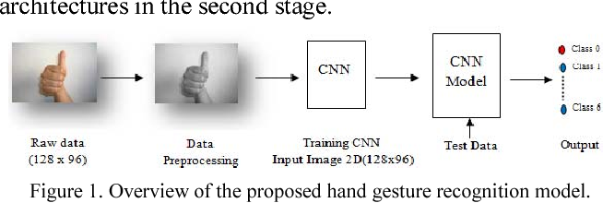
Gesture Recognition Model
Classification Model based on CNN (Convolutional Neural Network)
Capture live video stream from a camera
Classify the input images into six categories (Gestures of number 0-5)
Pass the predicted labels to Arduino and implement corresponding functions

Slide 13
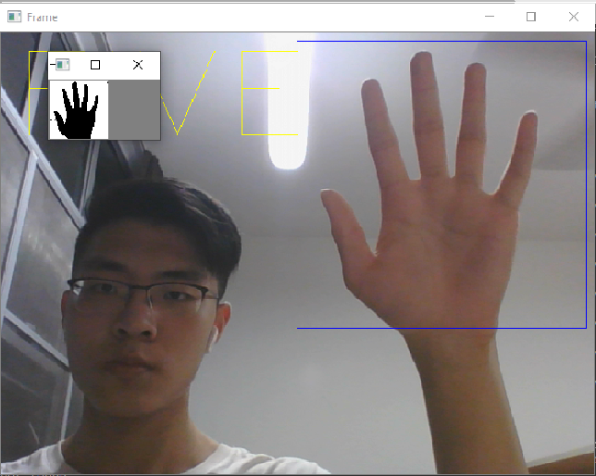
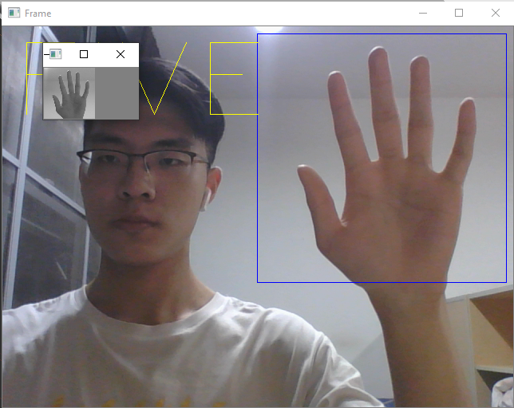
Training Process
1. Convert the input images(originally RGB images) into grayscale
2. Convert the grayscale images to binary pixels
3. Trained a CNN Model of 8 hidden layers
RGB Grayscale B&W

Slide 14

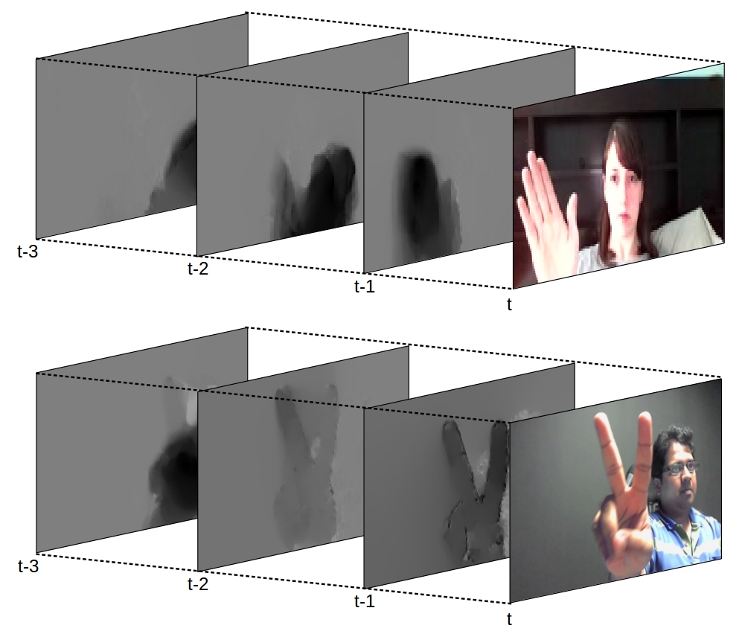
Real-time gesture detection

Slide 15


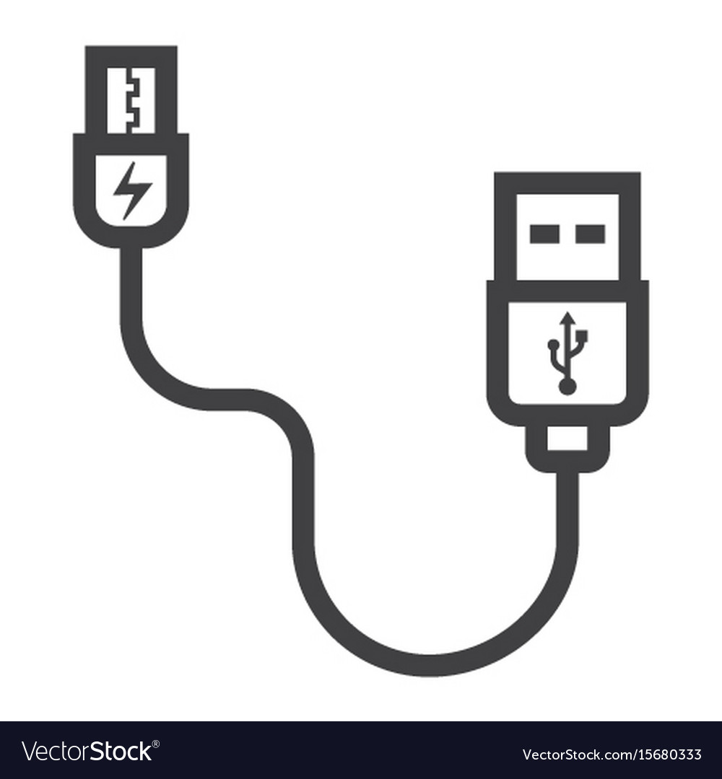
Data transmit between devices
Python
USB-serial port
Write
Pyserial
Arduino
Micro-usb serial port
Read
Serial.read()

Slide 16
Data transmit between devices
Python
USB-serial port
Write
Pyserial
Arduino
Micro-usb serial port
Read
Serial.read()

Slide 17
Arduino Implementation
Prototype: Recognizing and reacting
Green LED: Alarm button or call bell
ESP32: Light control
AM2320 Sensor: Humidity and temperature monitoring
One gesture master device to realizing 3 or more functions, can save lots of manpower in hospital and help patients cut their waiting time for nurses to come.

Slide 18
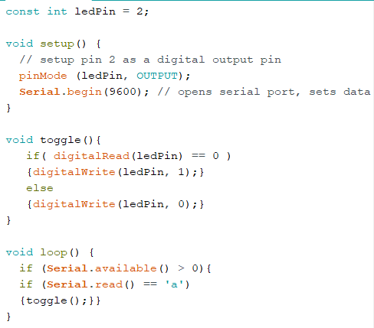
Build the prototype device achieving the basic function of recognizing gestures to turn on/off the LED on ESP32.

Slide 19
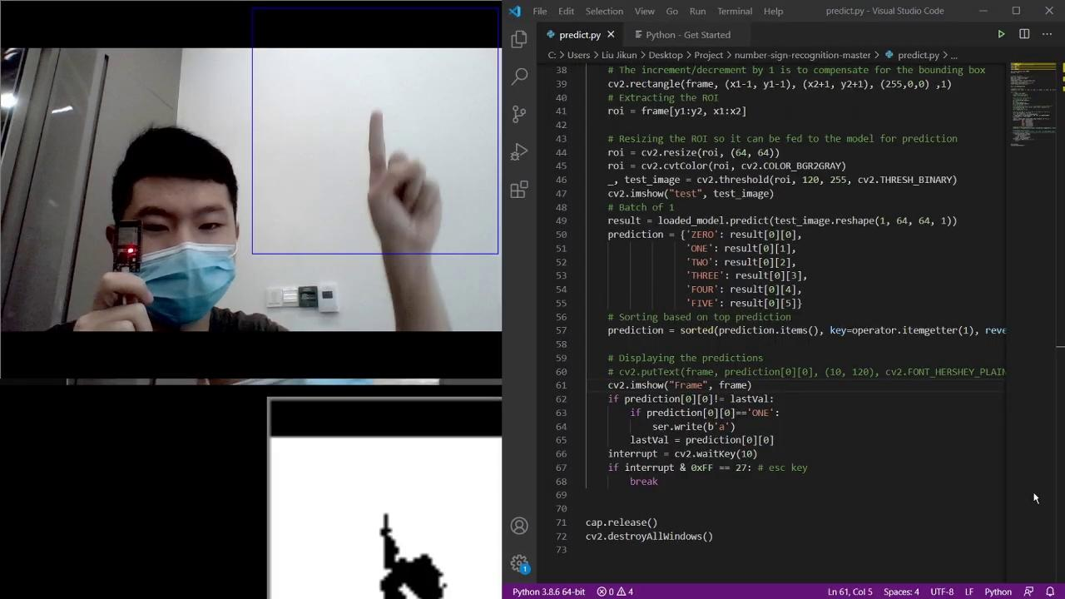
Use the blue LED on ESP32 to simulate the lights in the ward so that the patients can control lights on/off with one gesture at the most convenience.

Slide 20
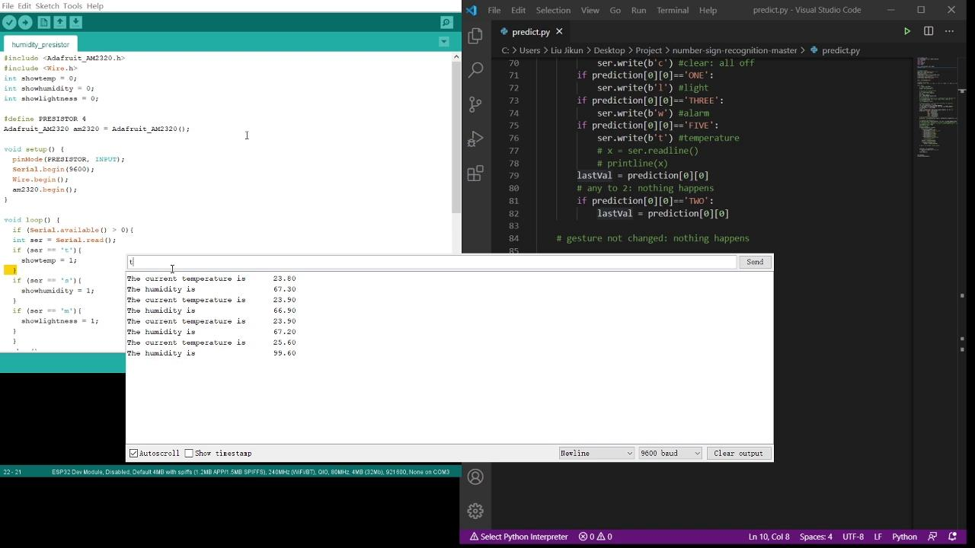
Use AM2320 Sensor to detect the humidity and temperature of the ward. Display on the screen once the corresponding gesture is recognized.

Slide 21
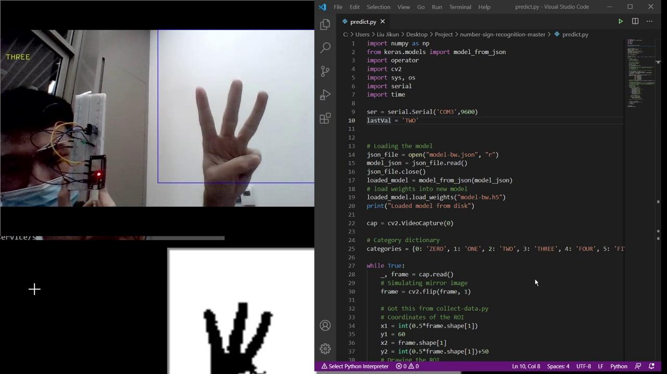
Use the Green LED to simulate the call bell in the ward. Patients can call nurses and doctors quickly and effectively.

Slide 22
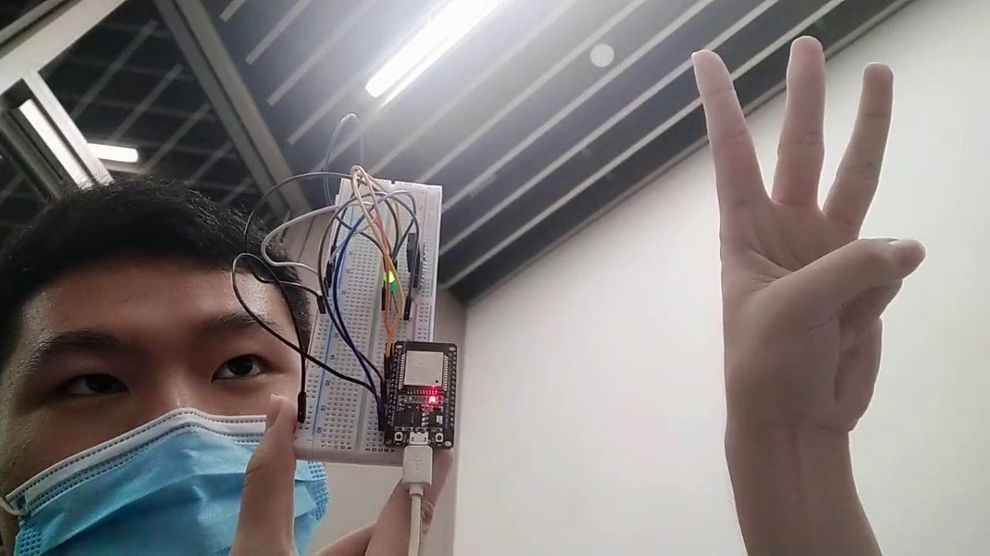
Use the Green LED to simulate the alarm button in the ward. Patients can call nurses and doctors quickly and effectively.

Slide 23
Application in real life
Notes:
There are not only number signs, but a much larger range of gestures

Slide 24
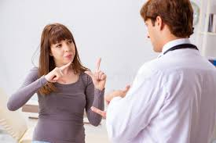
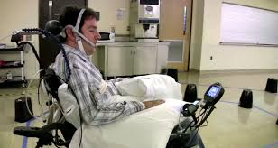
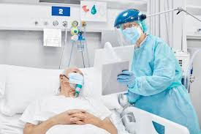
Scenario mainly hospitals
Targets patients

Slide 25


Make life easier
Entertainment
Service
Comfort

Slide 26
Most Important!!!
Emergency self-help

Slide 27
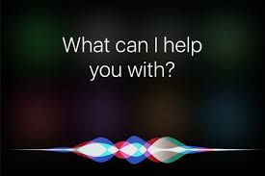
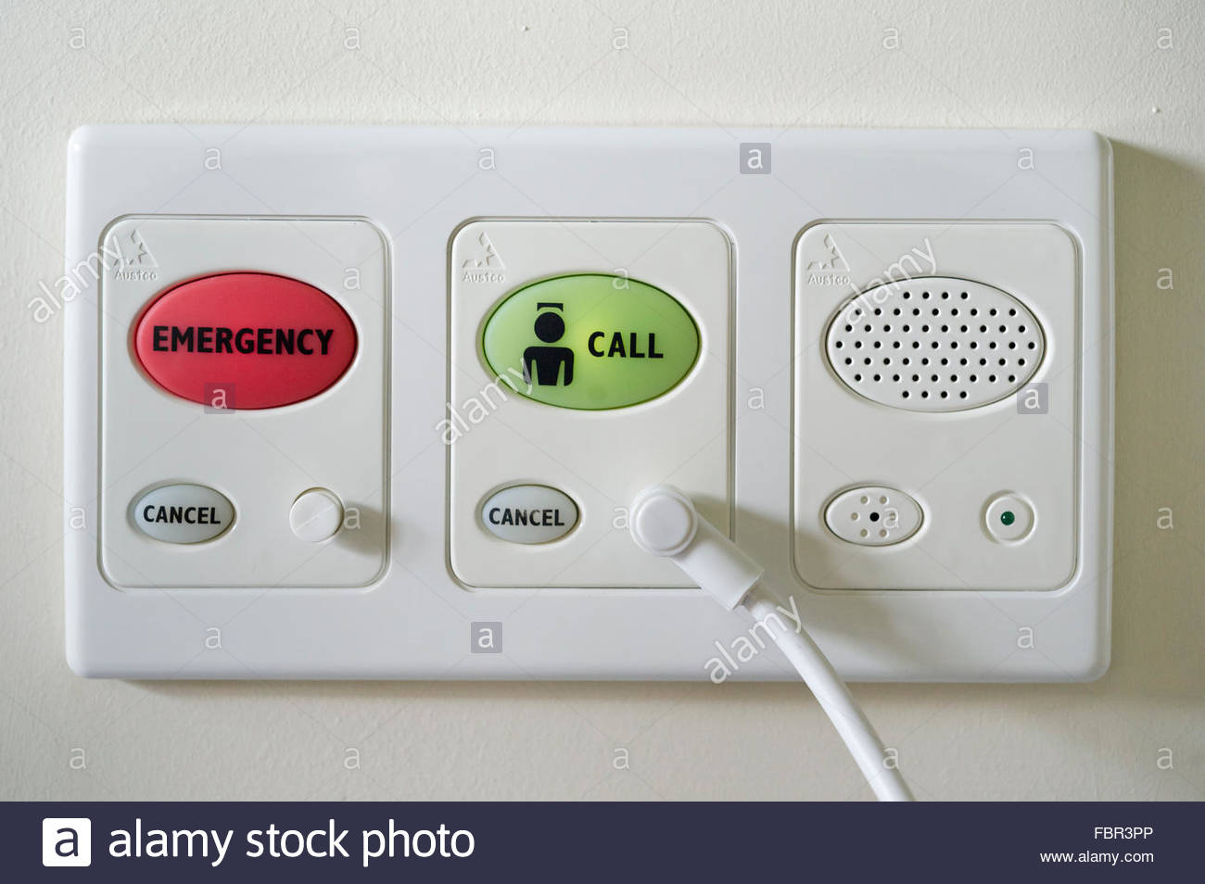
Why Gesture Master
Siri
Buttons

Slide 28
Conclusion
Notes:
In conclusion, through the automation of equipments around the patients with machine learning algorithm. We aim to reduce the need for more manpower by the healthcare system. Thus providing better services for the patients and working towards a more efficient and helping to build a more technologically advance healthcare sector in Singapore.

Slide 29
Thank You!

